Slide 1
New Jersey’s
Clean Energy ProgramTM
Clean Energy and Efficiency Opportunities for Residential, Commercial, Industrial, Multifamily, and Institutional Buildings
January 17, 2024
Notes:
TITLE SLIDE OPTION A

Slide 2
What is Combined Heat & Power?
Distributed energy
NJCleanEnergy.com/CHP
Combined Heat and Power (CHP) is the production of electricity and useful thermal energy from a single fuel source
Fuel Cells (FC) produce electricity through an electrochemical reaction from a fuel source
2
Notes:
Here is a quick simplified look at how a combined heat and power system works.
A fuel source – usually natural gas – is used to spin a turbine that creates electricity. In most cases, the cost of the generating system pays for itself quickly by generating electricity less expensively than the user would need to pay the utility.
With a conventional generator, the hot exhaust would just be vented to the outside air. But with a CHP system, that hot exhaust is used to heat water that can be used for steam or hot water.
And by using the heated exhaust instead of burning more natural gas to heat water, demand for gas is reduced as well, yielding even more savings.

Slide 3
CHP Applications, Examples & Decarbonization

Slide 4
What Are the Benefits of CHP?
CHP is more efficient than separate generation of electricity and heat
CHP can operate on a variety of fuels including biomass, biogas, natural gas, hydrogen, syngas or a blend of any or all of these
Higher efficiency translates to lower operating cost, (but requires capital investment)
Higher efficiency offers opportunities for reduced emissions
CHP can also increase energy reliability and enhance power quality
On-site electric generation reduces grid congestion and avoids distribution costs

Slide 5
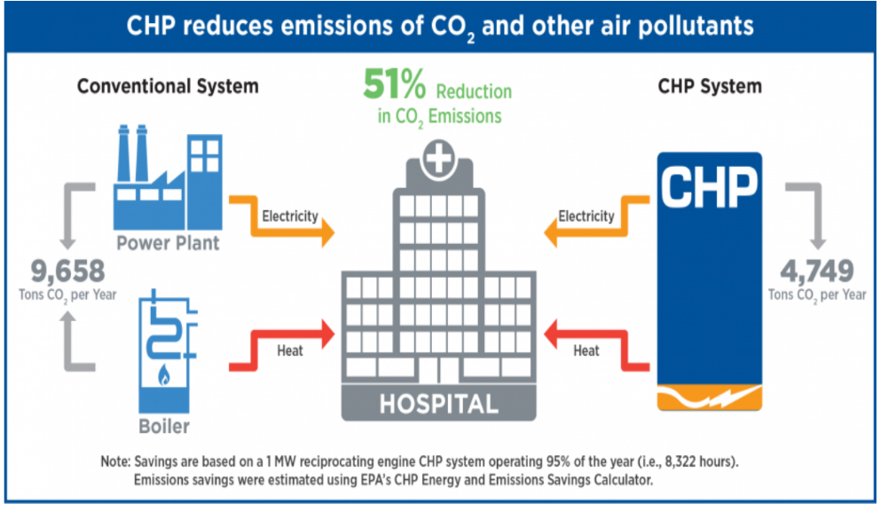
CHP Provides Energy Efficiency and Reduced Emissions of CO2 and Other Air Pollutants
Source: https://www.epa.gov/chp/chp-hospitals-superior-energy-superior-patient-care

Slide 6
Attractive CHP Markets
Industrial
Food processing
Petrochemicals
Pharmaceuticals
Plastics
Pulp and paper
Metals processing
Manufacturing
Commercial
Data centers
Hotels and casinos
Multi-family housing
Laundries
Apartments
Office buildings
Refrigerated warehouses
Institutional
Hospitals
Universities & colleges
Wastewater treatment
Correctional Facilities
Agricultural
Dairies
Wood waste (biomass)
Controlled Environmental Agriculture

Slide 7
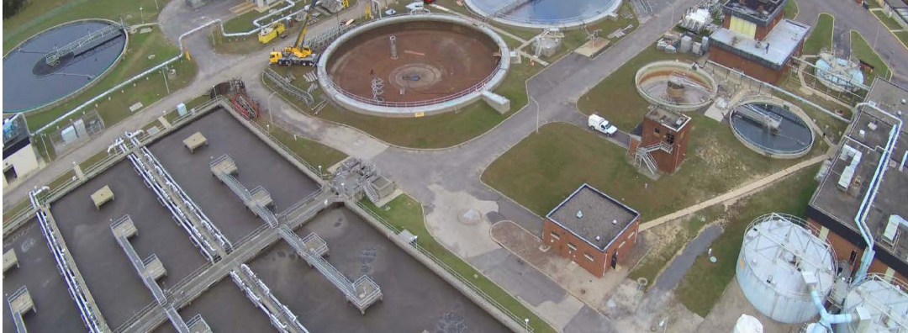
Project Snapshot:
Renewable CHP
Gloucester County Utilities Authority
West Deptford, NJ
Application/Industry: WWTP
Capacity: 1.2 MW
Prime Mover: Reciprocating Engine
Fuel Type: Biogas
Thermal Use: Process steam
Installation Year: Pre-approved and pending
The WWTP previously operated two incinerators that reduce the dewatered sludge generated as part of plant operations. As per the 2010 US EPA regulations, the incinerators would have to be equipped with capital intensive emission control systems by 2016 to allow continued operation. Investigations revealed that the construction and operation of Anaerobic Digesters with a biogas fueled Combined Heat and Power (CHP) system is more cost effective than completing upgrades to the aging incinerators. GCUA just closed on a loan from the NJ Water Bank to fund the project.
Source TRC & NJ I-Bank

Slide 8
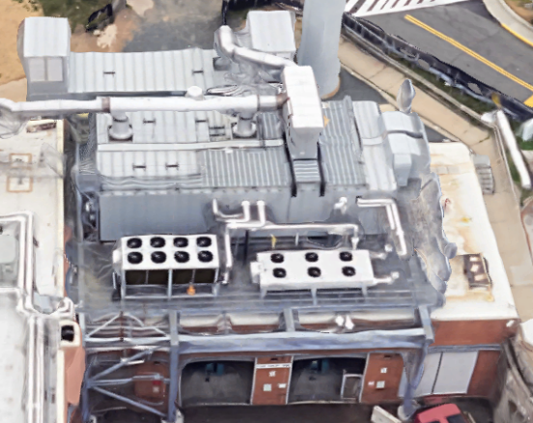
Project Snapshot:
On-Site Resilience & Cost Savings
Cooperman Barnabas Medical Center
Livingston, NJ
Application/Industry: Healthcare
Capacity: 2.5 MW
Prime Mover: Reciprocating Engine
Fuel Type: Natural Gas
Thermal Use: Heating & Cooling
Installation Year: 2022
Cooperman Barnabas Medical Center (CBMC) is a fully accredited acute care hospital and offers a comprehensive array of services. CBMC treats over 3 million patients and has 37,000 employees. In 2022 CBMC started operation of a 2.5 MW CHP plant located adjacent to the existing central boiler plant providing power, steam, hot water and chilled water that is distributed throughput the campus. RWJBarnabas Health is in process of installing three additional CHP plants at their hospitals that are anticipated to be on line in 2024 and 2025.
Source ICHPS

Slide 9
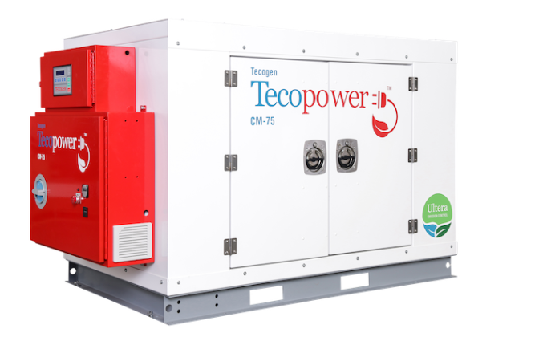
Project Snapshot:
Packaged CHP
Merck Pharmaceutical
Rahway, NJ
Application/Industry: Research Facility
Capacity: 150 kW
Prime Mover: Reciprocating Engine
Fuel Type: Natural Gas
Thermal Use: Space conditioning
Installation Year: 2021
Merck Pharmaceutical is a premier healthcare company engaged in the business of research, development, and manufacturing of various medicines for over 125 years. The research facility located in Rahway, implemented two 75 kW packaged natural gas fired CHP system for one of the buildings within the campus.
Source TRC

Slide 10
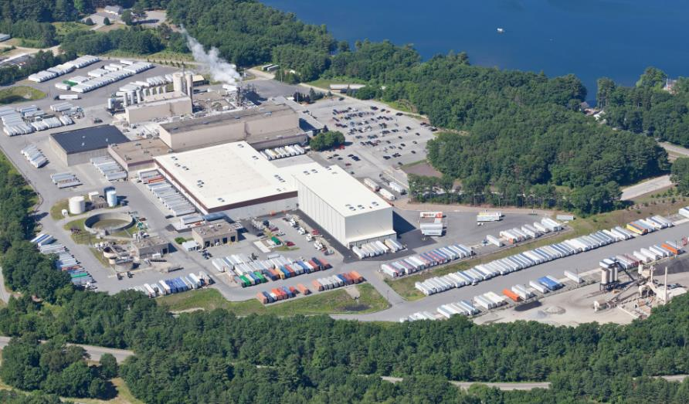
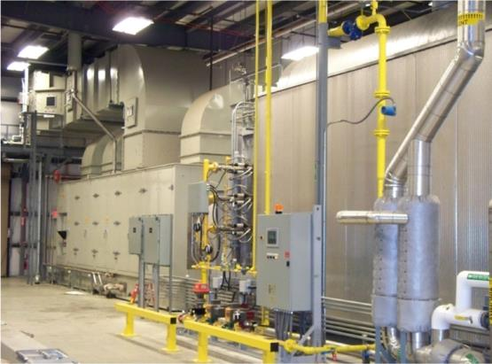
Project Snapshot:
Grid Congestion Relief
Frito-Lay North America
Killingly, CT
Application/Industry: Food processing
Capacity: 4.6 MW
Prime Mover: Gas turbine
Fuel Type: Natural gas
Thermal Use: Process steam
Installation Year: 2009
Testimonial: “Working with the State of Connecticut and the Department of Energy, we were able to invest in sustainable business practices that benefit this community and the country by providing relief to the Northeast power grid and using technologies with a lower environmental impact.” - Leslie Starr Keating, Senior Vice President of Supply Chain North America Foods, PepsiCo
Source: http://www.energy.gov/sites/prod/files/PepsiCo_Frito-Lay_CHP_Case_Study_07.02.15.pdf

Slide 11
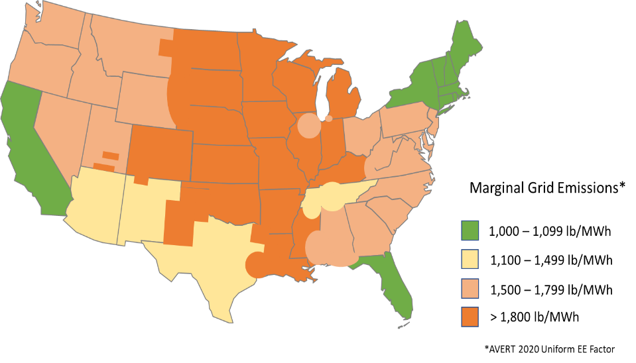
CHP Reduces CO₂ Emissions in All Regions Today
CHP and renewables displace marginal grid generation (including T&D losses)
Marginal generation is currently a mix of coal and natural gas in most regions of the US
CHP’s high efficiency and high annual capacity factor currently results in significant annual energy and emissions savings
“Because emissions are cumulative and because we have a limited amount of time to reduce them, carbon reductions now have more value than carbon reductions in the future. The next couple of decades are critical.”
Regional Marginal Grid Emissions Factors based on EPA AVERT 2021
Source: “Time Value of Carbon”, Larry Strain, Carbon Leadership Forum, April 2020
Notes:
This chart shows regional marginal generation emissions factors for today based on EPA AVERT model – you can see the emissions range range from 1,000 to 1,100 lbs CO2/MWh for Ca, NY and New England and Florida – to over 1,800 lbs/MWh in most of the midwest and central states.
Again, remember from the last slide that well-run natural gas CHP has emissions factors ranging from 430 to 610 lbs of CO2 per MWh
While economy-wide electrification and decarbonization of electricity generation is being pursued aggressively in many states and cities, fossil fuels, and natural gas specifically, are likely to remain as the marginal generation resource for the near and mid term, and may be necessary over the longer term in some regions to support the integration of greater amounts of renewable resources and provide needed grid regulation services.

Slide 12
CHP’s High Efficiency Saves CO₂ Emissions Today
CHP and renewables displace marginal grid generation (including T&D losses)
Marginal generation is currently a mix of coal and natural gas in most regions of the US
CHP is a low carbon resource, not a zero-carbon resource like PV & Wind, but it reduces grid carbon by displacing higher marginal emission sources
CHP’s high operating efficiency and high capacity factor enables it displace more marginal grid generation and reduce more CO₂ than the same capacity of zero carbon wind or PV
Category | Natural Gas CHP | Utility Solar PV | Utility Wind | Biogas CHP
Capacity, MW | 1.1 | 1.1 | 1.1 | 1.1
Annual Capacity Factor | 80% | 24.3% | 34.3% | 80%
Annual Electricity, MWh | 7,709 | 2,342 | 3,305 | 7,709
Annual Thermal Provided, MWh_{th} | 8,831 | None | None | 8,831
Annual Energy Savings, MMBtu | 40,834 | 21,065 | 29,733 | 40,834
Annual CO₂ Savings, Tons | 4,019 | 1,796 | 2,677 | 8,114
Savings based on EPA AVERT Uniform EE Emissions Factors as a first level estimate of displaced marginal generation (https://www.epa.gov/avert)
Prepared by: Entropy Research, LLC, 7/28/2022
Notes:
This table shows the energy and emissions savings from the 1.1 MW natural gas recip engine CHP system on the previous slides lined up with the energy and CO2 savings from 1.1 MWs of utility scale solar PV and 20 MW of Wind capacity
First, it’s important to note that CHP, like energy efficiency projects and renewable projects, displaces marginal grid generation (including T&D losses)
And today, that marginal generation is currently a mix of coal and natural gas in most regions of the US
You can see that the annual CO2 savings from natural gas CHP today, a technology that is not zero emissions, is of the same order as the annual savings from 1.1 MW of PV and Wind, and that’s due to the high annual operating hours and high efficiency of properly designed and operated CHP system The higher operating hours are reflected in the much higher annual capacity factor of 80% for CHP vs the 2021 national averages of 24% for PV and 34% for Wind
And you can also see how CHP’s savings further increase if that system was fueled by biogas or some other net-zero fuel
Assumptions:
CHP based on 1.1 MW Recip Engine CHP - 37.5% electric efficiency, 4.3 MMBtu thermal output, 80.6% total CHP efficiency,– Derived from DOE CHP Technology Fact Sheets, 2017
CHP annual capacity factor is 80%, typical of well designed and operated institutional CHP systems
Capacity factors for PV and wind based on 2019 National averages - Source: DOE Electric Power Monthly, Feb 2020
CHP, PV, and Wind displace national EPA AVERT Marginal Generation (2021 data) resources as an estimate of displaced marginal generation – 8,996 Btu/kWh, 1,534 lbs CO2/MWh, 5.3% T&D losses;
CHP thermal output displaces 80% efficient on-site natural gas boiler with NOx emissions of 0.1 lb/MMBtu

Slide 13
Decarbonization / Energy Markets / Grid Reliability
According to the New York ISO short term reliability margin are “thinning” to 2026.
NYC reliability margin narrows to 50 MW in 2025
“Even the slightest deviations from expected conditions, load forecasts, or project delays could trigger future reliability needs” - NYISO
CHP is fuel flexible - CHP currently uses renewable fuels, low carbon waste fuels, and hydrogen where available, and will be ready to use higher levels of biogas, renewable natural gas (RNG) and hydrogen in the future
CHP’s high efficiency can extend the supply of renewable, low carbon and hydrogen fuels and provide dispatchable net-zero generation and regulation support to maintain the long-run resource adequacy of a highly renewable grid

Slide 14
IRA Tax Credits
Inflation Reduction Act increased the ITC for CHP
CHP is eligible for a ‘bonus rate’ 30% Investment Tax Credit (ITC)
Taxpayers receive the bonus rate for meeting the prevailing wage and apprentice requirements. Projects under 1 MW are exempted from these requirements.
Applicability to Government and Non-Profit entities
Organizations exempt from tax under subtitle A of the Internal Revenue Code including hospitals and universities are “applicable entities” for direct payments.
Plus 10% Points: Domestic Content Bonus
To meet the domestic content requirement the facility must use 100% domestic iron and steel and a specified percentage of domestic manufactured products.
Deadline for the Sec. 48 ITC to January 1, 2025.

Slide 15
Combined Heat & Power – Feasibility Study Introduction
Clean Energy and Efficiency Opportunities for Residential, Commercial, Industrial, Multifamily, and Institutional Buildings
Notes:
TITLE SLIDE OPTION A

Slide 16
Combined Heat & Power - Fuel Cells Program
Distributed energy
NJCleanEnergy.com/CHP
WHO
Existing and new construction commercial, industrial, and large multifamily properties with a commercial account
Best suited for facilities that have year-round coincident power and thermal loads
SIZE TO QUALIFY
N/A - Projects must run 5,000 full load equivalent hours per year (3,500 for critical facilities)
ABOUT
Combined Heat and Power (CHP) systems allow for efficient on-site power generation with heat recovery, resulting in:
Reduced demand on the power grid
Lower energy bills
Less greenhouse gas emissions
Systems can also be designed to operate as backup power in emergencies
16
Notes:
To qualify for incentives, a CHP system must have a minimum run time of 5000 full time equivalent hours annually, 3500 for critical facilities. There are some other important requirements for a qualifying CHP system including combined efficiency of at least 60%.
One big barrier to more use of CHP systems has been that it can be costly to simply determine whether your facility is a good candidate. And there’s very good news on that front. Now there’s a new incentive that will pay for 50% of a feasibility study – up to $50,000. Now it will be possible to learn about using CHP at your facility at half the cost. And there’s no obligation to move forward if you choose not to after the study.
The incentives vary based on the type of system, the type of fuel being used, and whether the buildings are critical facilities and can amount to as much as $3 million.

Slide 17
Combined Heat & Power - Fuel Cells Incentive
Distributed energy
NJCleanEnergy.com/CHP
Size
(installed rate capacity)
Incentive
($/Watt)
% of Total cost cap
per project
Eligible Technology
$ Cap per project
≤500kW
$2.00
CHP powered by non-renewable or renewable fuel source, or a combination
Fuel Cell with Heat Recovery
30-40%
$2 million
>500kW-1MW
$1.00
>1MW-3MW
$0.55
30%
$3 million
>3MW
$0.35
Same as above
Applicable amount above
30%
$1 million
Fuel Cell without Heat Recovery
≤1MW
$1.00
30%
$2 million
Waste Heat to Power
>1MW
$0.50
30%
$3 million
Bonus Incentives:
- 25% bonus for critical facilities with black-start/islanding capabilities
- Up to 30% incentive bonus for CHP using biofuel
17
Notes:
The chart that you see here is on our website – njcleanenergy.com. It’s here to show you that there are many different options to find great incentives for combined heat and power systems of every size. Fuel cell technology is also supported, and the program offers flexible options there too.
This program has generous incentives that help to make CHP even more attractive. Here’s an example: A high rise apartment building might be considering a combined heat and power system. Let’s say they’ve decided that they need a 500 kilowatt system. 500 kW is 500,000 watts. The incentive is $2.00 / watt. That means that they could be eligible for $1,000,000.
A large regional high school might use a 50kw system. Using the same math, they could be eligible for $100,000.
And here’s a cool feature. When a system exceeds one incentive tier the incentive per watt goes down, but the total incentive doesn’t. Here’s how it works. Let’s say that high-rise needed a 600 kW system. The first 500 kW is still eligible for $2.00 per watt - $1,000,000. Then the next 100 kw is incentivized at $1.00. That’s another $100,000 for a total of $1.1 million.

Slide 18
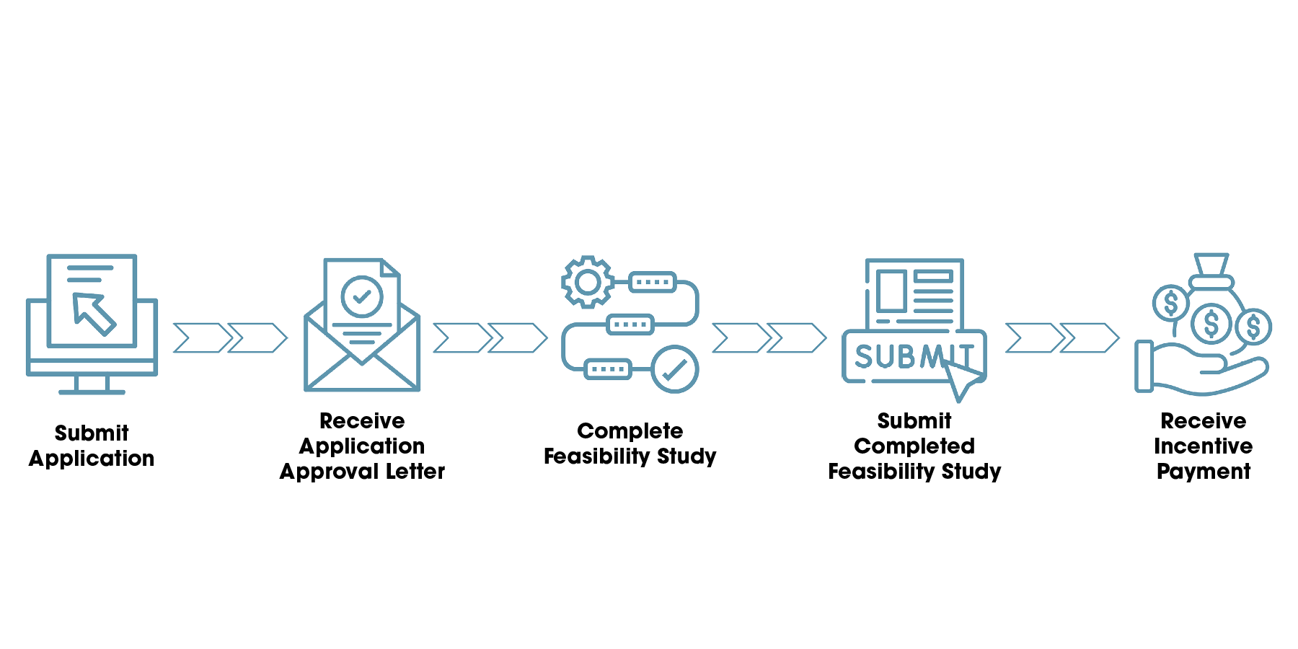
How do I Participate?
Distributed energy
NJCleanEnergy.com/CHPFeasibility

Slide 19
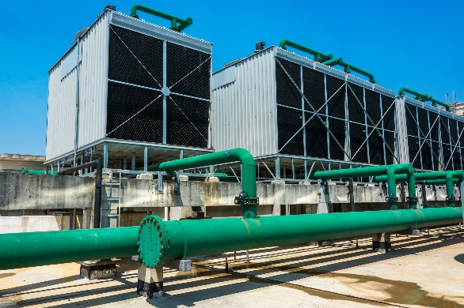
Combined Heat & Power Feasibility Study Program
Distributed energy
NJCleanEnergy.com/CHPFeasibility
Is a CHP system right for me?
The CHP Feasibility Study will evaluate if the solution of combined heat and power systems and fuel cells repurposing electricity and waste heat suits your property
There are incentives for a CHP Feasibility Study to offset the cost to evaluate if this solution is right for you
Incentives will offset up to 50% cost of the feasibility study, capped at $50,000
19

